Slide 1
Organization behaviour & culture
By Miss Noreen

Slide 2
About MEMBERS
NOOR BAHO
Freelancer (Web Developer – Back End)
Skills: Web Development, Python, JavaScript, PHP
ADNAN SHAHID

Slide 3
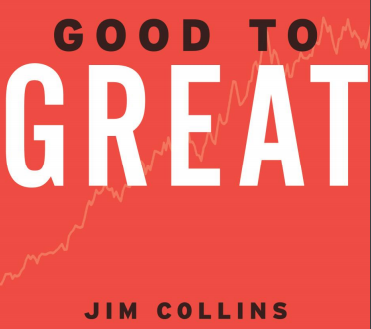

Slide 4
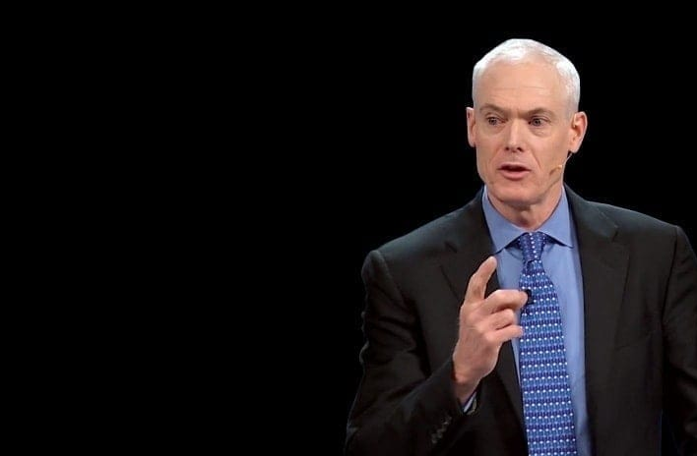
JAMES COLLINS(1958-Present) (JIM COLLINS)
Publications:
Built To Last (1994)
Beyond Entrepreneurship (1995)
Good To Great (2001)
Good To Great And
The Social Sectors (2005)
How The Mighty Fall (2009)
Great By Choice (2011)

Slide 5
Challenge
Collins’ friend Bill Meehan
Collin wrote only about “Great Companies”
Built to Last (1994)
Is the disease “To be Good” curable

Slide 6
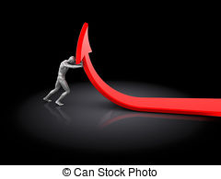
“Can a Good Company Become a Great Company?”

Slide 7
Facts & Figures
5 Years of Research
21 Members of Research Team
Researched over 28 Companies who sustained their great results for 15 years
Compared 14 “Great Companies” with 14 “Failed Companies”

Slide 8
Overview
Good is enemy of Great
Level 5 Leadership
First Who… Then What
Confront the Brutal Fact
The Hedgehog Concept
A Culture of Discipline
Technology Accelerator
The Flywheel & the Doom Loop
From Good to Great to Built to Last

Slide 9
“Good is the enemy of great”
Jim Collin

Slide 10
“Just Being Good”
Great Companies have always been great,
Good Companies remain just that good.
Because of disease

Slide 11
Companies Pick-up Standard
15 years Cumulative Stock Returns at or below the general stock market.
Punctuated by a Transition Point.
Cumulative Returns at least 3 times the market over next 15 years.

Slide 12
Companies
3M
Boeing
Coca-Cola
GE
Hewlett-Packard (HP)
Intel
Johnson & Johnson
Merck
Motorola
Pepsi
Procter & Gamble
Wal-Mart
Walt Disney

Slide 13
Inside The BLACK BOX
Great Results
BLACK
BOX
Good Results

Slide 14
Levels of Management
Top Management
Middle Management
Operatives
Bottom Management (Front Line)

Slide 15
Level 5 Executive (Blend of Personal Humility & Professional Will)
Contributing Team Member (Contributes individual Capabilities to achieve group objectives)
Highly Capable Individual (Makes Productive Contributions through his skills)
Effective Leader (Stimulating Higher Performance Standards)
Competent Manager (Organizes People and Resources)
5-Top
4-Middle
3-Front line
2-
1

Slide 16
Level 5 Leader = HUMILITY + WILL

Slide 17
“Humbleness clothes you in dignity”
Hazrat Ali (r.a)

Slide 18
“You can accomplish anything in life, provided that you do not mind who gets the credit”
Harry S. Truman

Slide 19
Level 5 Leadership
BREAKTHROUGH!
Build Up . . . . .
Level 5
Leadership
First Who…
Then What
Confront The
Brutal Facts
Hedgehog
Concept
Culture Of
Discipline
Technology
Accelerators
DISCIPLINED PEOPLE
DISCIPLINED THOUGHT
DISCIPLINED ACTION
FLYWHEEL

Slide 20
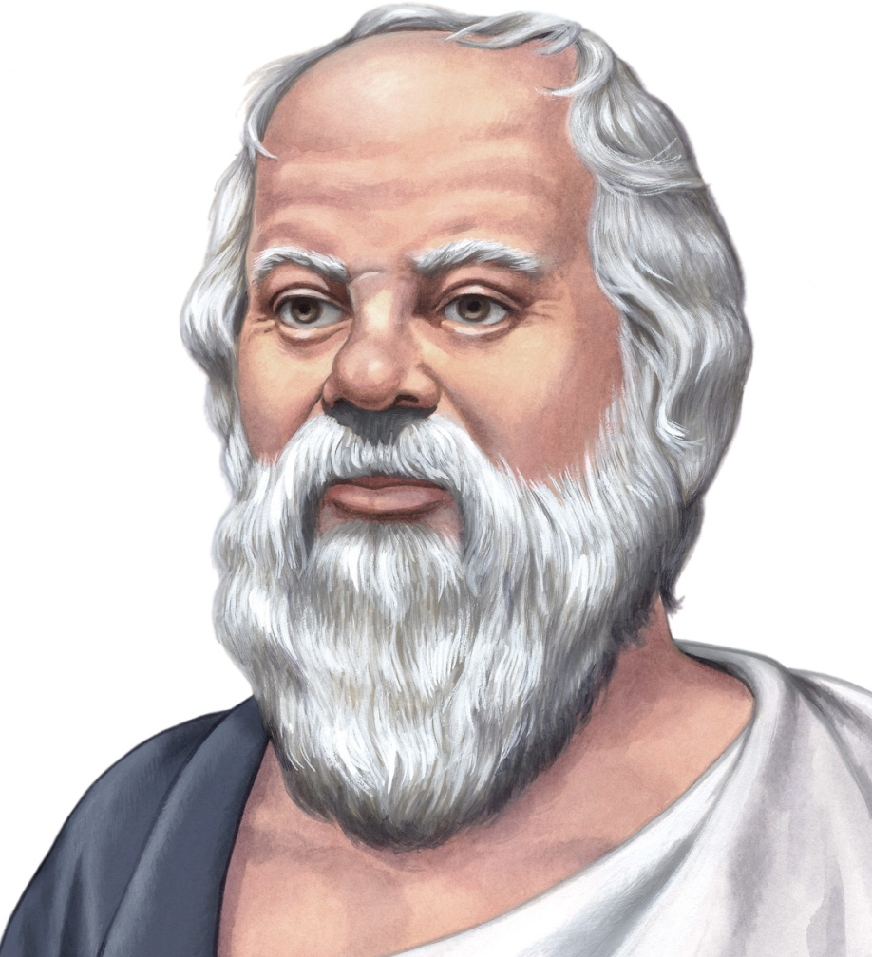
“There is only One good; Knowledge and One evil; Ignorance”
SOCRATES
SOCRATES
PLATO
Alexander The Great
ARISTOTLE

Slide 21
First Who… Then What (Disciplined People)
Right People on the Bus
Wrong People off the Bus
Right People in Right Seats
Then Where to Drive

Slide 22
Not a “Genius with a Thousand Helpers”
Genius with a Thousand Helpers
LEVEL 5 LEADER
First Who
Then What
First What
Then Who

Slide 23
“People are the most important asset”
The Old Proverb

Slide 24
Confront the Brutal Facts (Disciplined Thought)

Slide 25
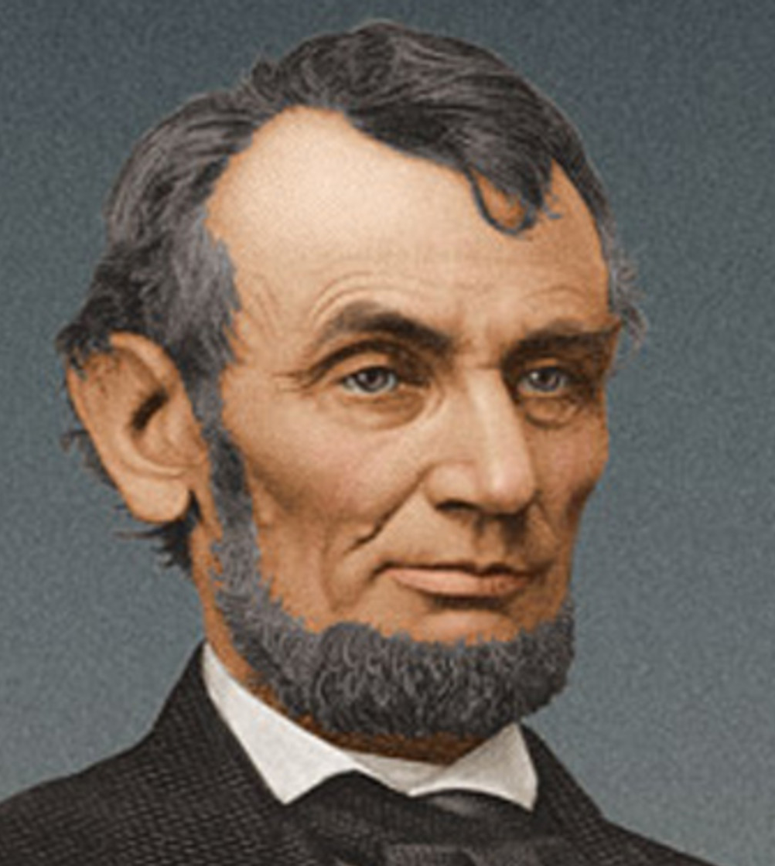
“Courage is not the absence of fear. It is going forward with the face of fear”
ABRAHAM LINKOLN (1809-1865)
16th US President
Lawyer & Politician
Led US through Civil War
Assassination 1865

Slide 26
A Climate Where the Truth is Heard
Lead with questions, not answers
Engage in dialogue and debate, not coercion
Conduct Autopsies, without blame
Build “Red Flag” Mechanisms

Slide 27
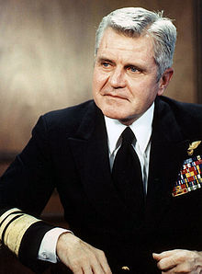
Stockdale Paradox
Retain faith that
you will prevail
in the end,
regardless of
the difficulties
Confront the most
brutal facts of
your current
reality, whatever
they might be
Admiral Stockdale (1923-2005) Prisoner of Vietnam War for over 7 years
At the Same Time

Slide 28

The Hedgehog Concept (Simplicity within the three circles)

Slide 29
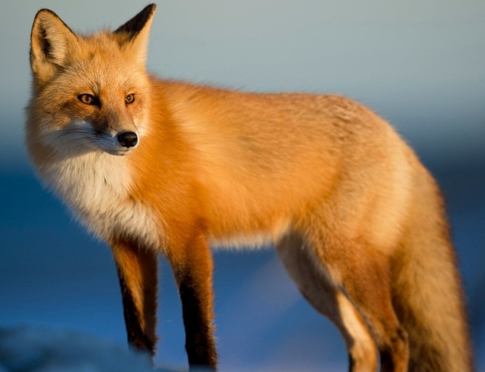
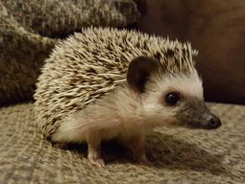
“The fox knows many things, but the hedgehog knows one big thing”BERLIN
WORLD
Cunning Creature
Dowdier Creature

Slide 30
“Hedgehog Concept is not a strategy to be the best, but an understanding of what you can be the best at”
What You are deeply PASSIONATE ABOUT?
What Drives
Your ECONOMIC
ENGINE?
What You
can be the BEST IN
THE WORLD
AT?

Slide 31
Hedgehog Circle
Identify “can be” and “cannot be”
Profit per x.
Not to stimulate, just to discover passion

Slide 32
Simple Ideas
Kroger Super-store Concept
Kimberly-Clark Paper based Consumer Products
Walgreens Drug Stores
Savour Foods Rice Point

Slide 33
ADNAN SHAHID will Continue. . .

